Slide 1
Research Paper Simplification

Slide 2
Problem formulation
Task: Text Simplification with inference on research paper.
Objective: Develop model to automatically simplify complex text while preserving its meaning and coherence.
Challenges encountered:
Limited Training Data: Overcoming the constraint of limited labelled training data.
Varied Sentence Structures: Adapting to diverse sentence lengths and structures in the dataset and research papers.
Contextual Dependencies: Capturing nuanced contextual dependencies for accurate simplification.
Simplicity vs. Content Preservation: Striking a balance between simplicity enhancement and preserving critical content.
Dataset
Constructed a diverse dataset by amalgamating data from Hugging Face's ASSET and Turk repositories, featuring pairs of complex and simplified sentences.
Ensured a balanced representation encompassing various linguistic complexities.
Evaluation:
Employed comprehensive metrics such as BLEU score, ROUGE score, and human evaluation to rigorously assess the quality of simplification.
Emphasis on innovating models to enhance readability without compromising semantic fidelity.
Focus:
Addressing Lexical Simplification challenges in the context of research papers.

Slide 3
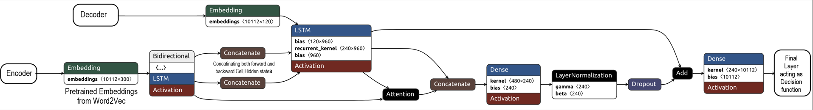

Model Architecture
We tried two different architectures. Both the models are Encoder-decoder models. Pre trained Word2Vec embeddings are fed into the Encoder as initial embeddings.
Model 1:
Encoder: Bidirectional LSTM for contextual understanding. Concatenation of forward and backward states for comprehensive representation.
Decoder: LSTM with attention mechanism for context-aware generation. Residual connection , Dense layers(Feed Forward Networks-FFNs), layer normalization for enhanced learning and stability.
Model 2,Model 3 :
Encoder: Bidirectional LSTM with dropout for robust feature extraction. Concatenation of forward and backward states for context preservation.
Decoder: LSTM with attention mechanism for capturing relevant information. Additional dense(FFNs) and dropout layers for improved generalization.

Slide 4
Rationale behind the architecture
Encoder-Decoder Framework:
Encoder refines the embeddings of the original text.
Decoder utilizes the refined embeddings to perform the simplification task.
Bidirectional LSTM:
Captures contextual information effectively.
Implemented in the Encoder for robust feature extraction.
Attention Mechanism:
Ensures the model focuses on relevant parts during generation.
Model 1 Design Choices:
Passing through additional feedforward network layers for feature preservation.
Residual connection for feature preservation and tacking vanishing gradient.
Layer normalization for stabilizing training and improving convergence.
Model 2 Design Choices:
Smaller version of Model 1.
Multiple feedforward network layers and dropout layers in the Decoder.
Contribute to better generalization and prevent overfitting.
Model 3 Design Choices:
We don't use version exponential decay of learning rate used in Model 2. Rest is same from Model -2.

Slide 5
Specifics of the model architecture (parameters, hyperparameters, loss function, optimizer)
Model 1:
Parameters: Latent Dimension: 120, Encoder Tokens: Adjusted to vocabulary size, Decoder Tokens: Adjusted to vocabulary size,Max Sequence Length: 140,Word2Vec Embedding Size: 300
Hyperparameters: Batch Size: 32, Epochs: 100,Validation Split: 0.2, Early Stopping: Patience=3, Restores best weights
Loss Function: Cross Entropy
Optimizer:Adam
Model 2, Model 3:
Parameters: Latent Dimension: 90, Encoder Tokens: Adjusted to vocabulary size, Decoder Tokens: Adjusted to vocabulary size, Max Sequence Length: 140, Word2Vec Embedding Size: 300
Hyperparameters: Batch Size: 32, Epochs: 50, Validation Split: 0.2, Learning Rate Schedule: Exponential decay (initial rate: 0.001 over 10 epochs for Model 2 only)
Loss Function: Cross Entropy
Optimizer: Adam with Learning Rate Schedule
Common Pre-processing:
Tokenization and padding of input and target sequences. Word2Vec Model from Google News is used, coverage is evaluated(79.14%)

Slide 6
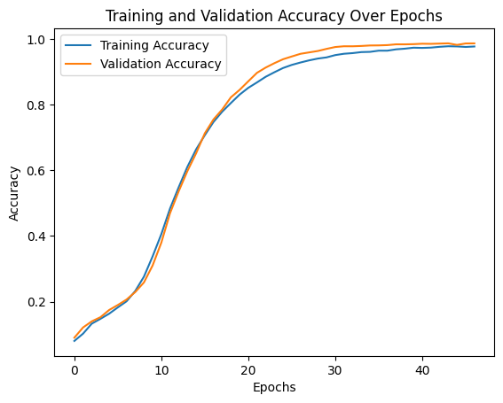
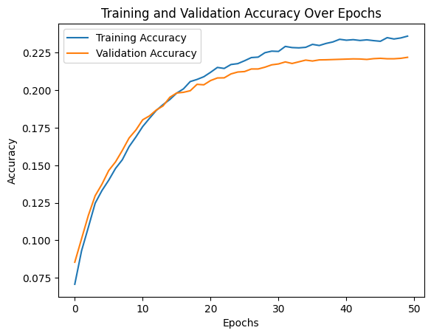
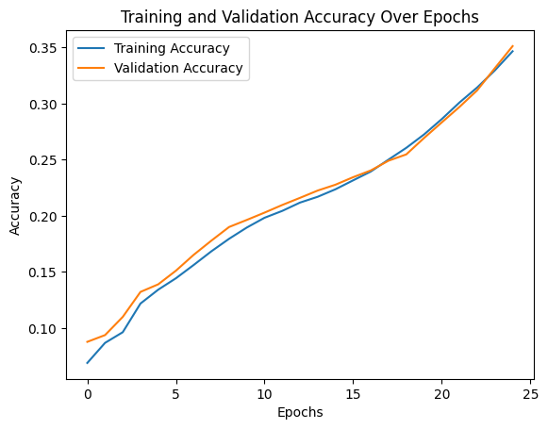
Results
Model 1: Epochs: 47/100 Training Loss: 0.0862, Training Accuracy: 97.73% Validation Loss: 0.2071, Validation Accuracy: 98.68% (Early Stopping)
Time per Epoch: 198s
Model 2(on the left below) : Epochs: 50/50, Training Loss: 4.3016, Training Accuracy: 23.60%,Validation Loss: 4.7674, Validation Accuracy: 22.19%, Learning Rate at End: 7.4466e-06
Model 3(On the right above) : Epochs: 50/50, Training Loss: 3.3213, Training Accuracy: 34.67%,Validation Loss: 3.2815, Validation Accuracy: 35.12%
Model 1 Evaluation(as it appears the best) on entire test data :
BLEU Score: 16.07%, BLEU Score with Smoothing: 16.07%, ROUGE-N Score: 0.08%, ROUGE-L Score: 0.00%
Interpretation: BLEU Score measures the precision of the model's output against the ground truth. ROUGE-N and ROUGE-L Scores evaluate overlap in n-grams and word sequences, respectively. They indicate moderate level of precision (16.07% BLEU Score) with no significant overlap in n-grams (0.08% ROUGE-N Score) or word sequences (0.00% ROUGE-L Score).

Slide 7
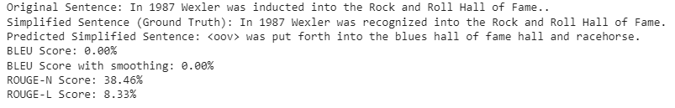
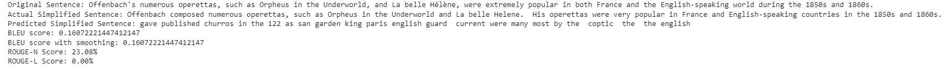
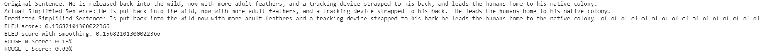
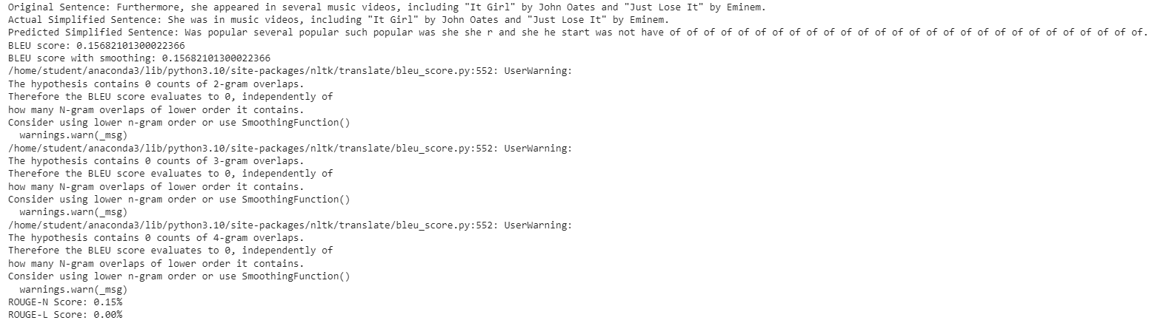
Results(Continued)
Evaluations on some random sentences :
Evaluation on random sentences using Beam Search :

Slide 8

Results(Continued)
Inferencing on a passage from Research paper :

